Slide 1
Configuration Management

Slide 2
Contents
What is Configuration Management?
Frequently Used Terms
Primary Activities
Process Flow
Plan & Setup Configuration Management
Baseline Maintenance
Change Control
Configuration Status Accounting
Configuration Auditing
Backup and Archival
Things to Remember
Recap

Slide 3

What is Configuration Management?
A disciplined approach to establish and maintain the integrity of the work products of the software project throughout the project’s life cycle.

Slide 4
Frequently used Terms
Work Products: Work products include the items or products that are delivered to the customer as well as the items or artifacts that are generated or required to create these software products
Configuration Items: All work products, which may require the maintenance and tracking of the multiple versions, are identified as Configurable Items (CIs)
Baseline: Configuration Information formally designated to a CI after it has been reviewed and approved to form the basis for future use is considered as baselined
Version Control: Establishing & maintaining baselines and identifying changes to baselines to make it possible to return to the previous baseline

Slide 5
Primary Activities
Identifying CIs in the system
Verifying the completeness and correctness of items
Controlling the change of these CIs throughout their life cycle
Recording and reporting the status of CIs and change requests
Maintaining the integrity and traceability of the product throughout their life cycle

Slide 6
Process Flow
Project Planning initiated
& SCM identified
Plan CM activities
Project Planning
Procedure
Prepare SCMP
Baselined SPP
Execute SCMP
Baseline Maintenance
Change Control
Backup and Archival
Configuration Auditing
Configuration Status
Accounting

Slide 7
Plan & Setup Configuration Mgmt.
Plan
CI identification
Baselining criteria
Naming convention for CI
Version numbering strategy
CM tool
Directory structure
Access Rights
Freq of status reporting & audit
Backup & archival
SCCB composition
Setup
Setup of tool
Preparation of dir. structure
Assign access rights
Train team

Slide 8




Baseline Maintenance
Baseline work product
Update Configuration
Status Report
Project Team
Work products
Criteria fulfilled
SCM
Check against
baselining criteria
Criteria not fulfilled

Slide 9
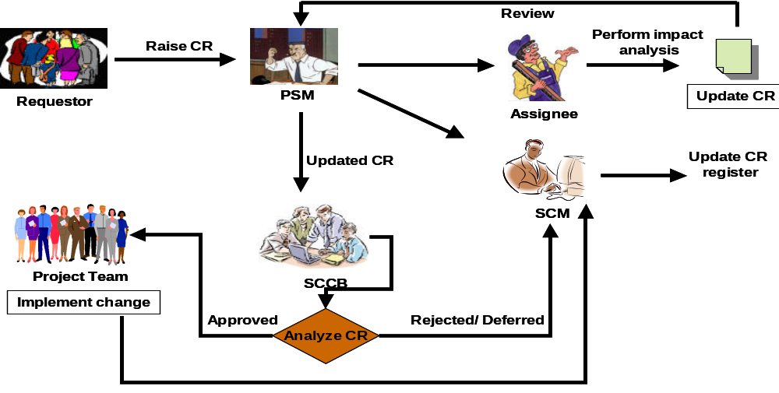

Change Control
Change Control: Change Request for all CI’s (Deliverable to client as per project plan) before and after the release to the client are initiated, recorded, reviewed, approved, and tracked according to the following process

Slide 10

Configuration Status Accounting
Status Accounting: To track all changes made to the baselined CIs, maintain change history and report the status of various CIs
Frequency from SPP (SCMP)
SCM
Updated Configuration Status Report
Stakeholders
(PSM/TL)

Slide 11

Configuration Auditing
Auditing: Selection and Evaluation of CIs for ensuring the consistency and completeness of this release
Study
SCMP
Peer SCM
Conduct audit
Record NC
Verify implementation
& update NC report
Send to
Take corrective action
& update NC report
NC report
SCM
SEPG-H, PSM

Slide 12



Backup & Archival
BACKUP
Data/software
Take backup
Project Team
Central server
System Admin
Update
Backup Strategy
ARCHIVAL
Work products
Archive data
PSM
SCM
File hardcopies
System Admin
Prepare index
Retain archives

Slide 13
Things to Remember
Reminders
Update CI versions and release as per SCM plan in SPP
Perform Configuration Audits as per schedule
Update Configuration Status Report regularly
QMS Reference Documents
FR_SUP_COM02 : Configuration Item List
PR_SUP_COM01 : Configuration Management
FR_SUP_COM15 : Change Request
FR_SUP_COM20 : Change Request Register
FR_SUP_COM25 : Configuration Status Report
FR_ENG_COM30 : Backup Register

Slide 14
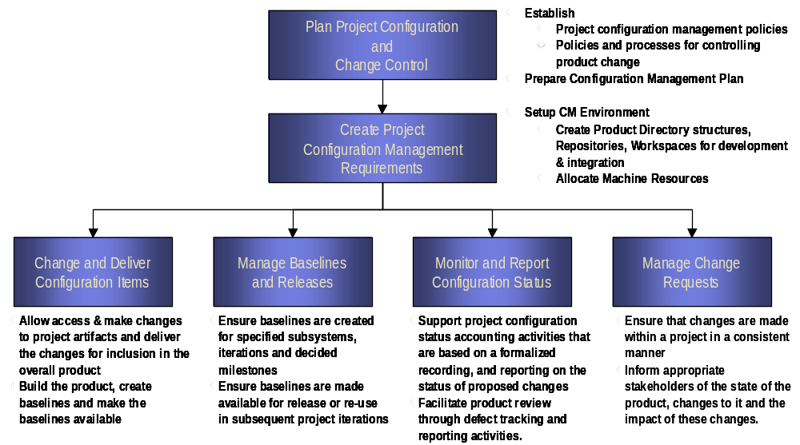
Recap

Slide 15
Thank You

